Slide 1

CLIQUE – Experience Luxury At Convenience

Slide 2











Clique – The Opportunity under Truevibez Umbrella
Clique is premium service offered to our finest customers & business partners, to mutually benefit through means of microfinancing services.
Dine Now, Pay Later
For customer expecting an event to visit restaurant but without available liquid funding, Clique will open up a line of credit in handshake with a lender (NBFC). The customer can request this restaurant-focused credit line and once approved, use it at any partner restaurant.
Merchant Employee Lending
Restaurant staff currently face many challenges in requesting loans from banks and NBFCs however from recommendation of a partner merchants, a lo-medium size credit pool will be made available to them with flexible repayment options.
With microfinance market anticipated to grow with CAGR of 40% through 2025, NBFC-MFIs will be its greatest beneficiaries. In F&B segment, unbanked microlending has only reached 12-15% of the prospective market.

Slide 3
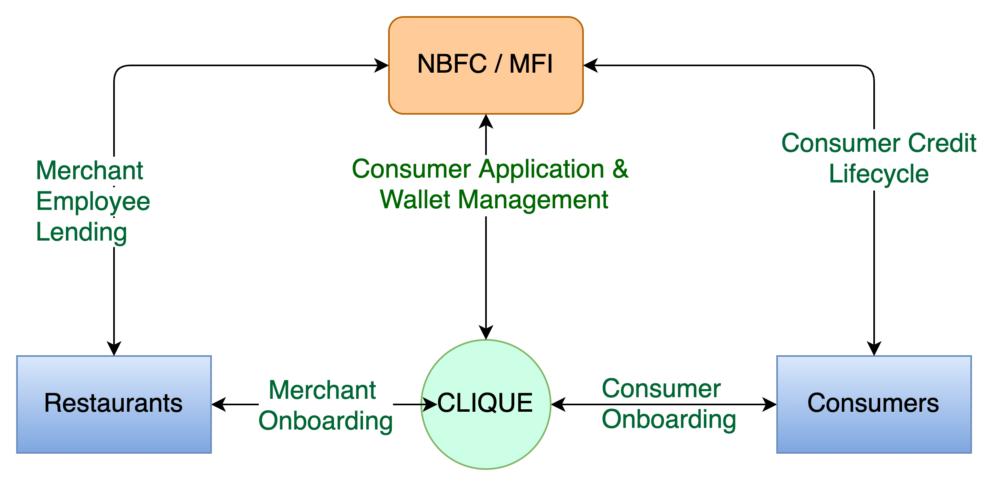
Clique – High Level System Flow
CASE STUDIES
Zomato, in partnership with InCred, to lend Rs 1L to 50k restaurants, developing loan book of 500CR
PAYO (Australia) – Launched ENPL service in July-21 & already has 500+ restaurant partners

Slide 4
Clique – Customer Onboarding Journey
02
Customer reviews standees, flyers, tent cards and informed by staff about Clique
03
Customer downloads Clique app and completes KYC application
01
Customer walks into
a restaurant
Clique routes the application to lender
06
Lender sends a confirmation back to Clique
04
05
Lender underwrites the customer
07
Clique updates customer app and reflects the wallet credits
08
Customer enjoys the F&B services
09
Customer pays through clique credit & returns home

Slide 5
Clique – 360° Benefits
Eat now, Pay Later
Consumers | Restaurants | MFI-NBFC
Increase in spend potential | Increased sales | New customers
Bio-authorization to reduce risks | Higher ticket size | Increased presence
No joining or renewal fees | New feature to offer | Competitive edge
Decorum & savings | No additional charges | Innovative offer
Microfinancing
Consumers | Restaurants | MFI-NBFC
Increased borrowing potential | Self-sufficiency at competitive rates | Untapped market – Millennials, Zoomers
Enhanced financial literacy | Standardized & organized system | Inclusive growth
Reactive credit scoring | Reduced regulatory challenges | Valued partnership
Better rates than banks | Co-branding opportunities | Benefit from geographic expansions

Slide 6






Question & Answers

